Slide 1
TITLE
Demarcation Point and Line at Hangar MIAT
Safety Department
26 September 2022

Slide 2
CONTENT
Introduction
Objective
Requirement
Process/Approach
Implementation

Slide 3
Introduction
The incident was apron safety that related to aircraft arrival/ take-off and aircraft mooring at apron Hangar MIAT with no clearly apron demarcation line/point. There was another aircraft startup concurrently within this activity.
Previous reporting also stated that aircraft startup was close to the hangar area and might cause FO(D)s to be blown into the hangar and excessive noise can pose a hearing risk to personnel in the vicinity of the area.

Slide 4
Objective
To emphasize SMS in the operation organisation and to meet the authority's requirements.
To control and minimize as low as reasonably practicable of any potential hazards and risks that affecting safety, causing personnel injury and damage to property or environment resulting from an accident/incident by referring to any sources or inputs.
To identify possible apron demarcation line/point for safe distance of any aircraft activities.
Contribute ideas, suggestions and implementing mitigation to improve safety towards a safer work area.

Slide 5
Requirement
CAD 19 – Issue 02 revision 00 – 17TH DECEMBER 2021 (3.3 Safety Risk Management).
CAGM 1902 – Issue 01 revision 00 – 17TH DECEMBER 2021 (4. Component 2: Safety Risk Management).
GAM SMS Manual – Issue 02 Amendment No.0 – 02 February 2022 [Part 9.0 Hazard Identification, Risk Assessment, Risk Mitigation And Management (HIRM)]

Slide 6
Process/Approach
Safer Card was issue on 14 Sep 2022.
Issue was brought up in 2nd SAG meeting on 22nd Sep 2022.
Safety walkabout at Hangar MIAT was carried out on 23rd Sep 2022.
Meeting invitation to related personnel or dept for further discussion on how to control and mitigate the incidents.

Slide 7
Process/Approach

Slide 8
Implementation
To develop, implement and maintain of SOP for standardization in operating any aircraft activities at apron within safe work distance.

Slide 9
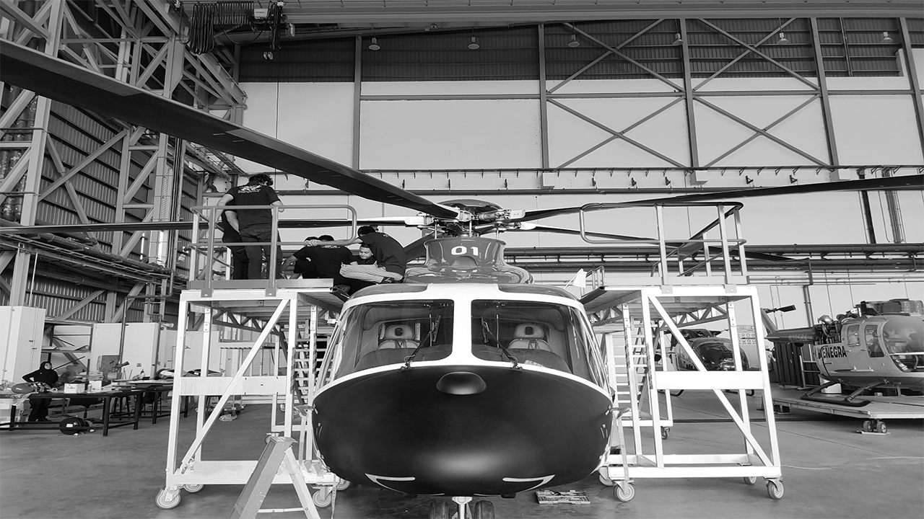
THANK YOU

