Slide 1
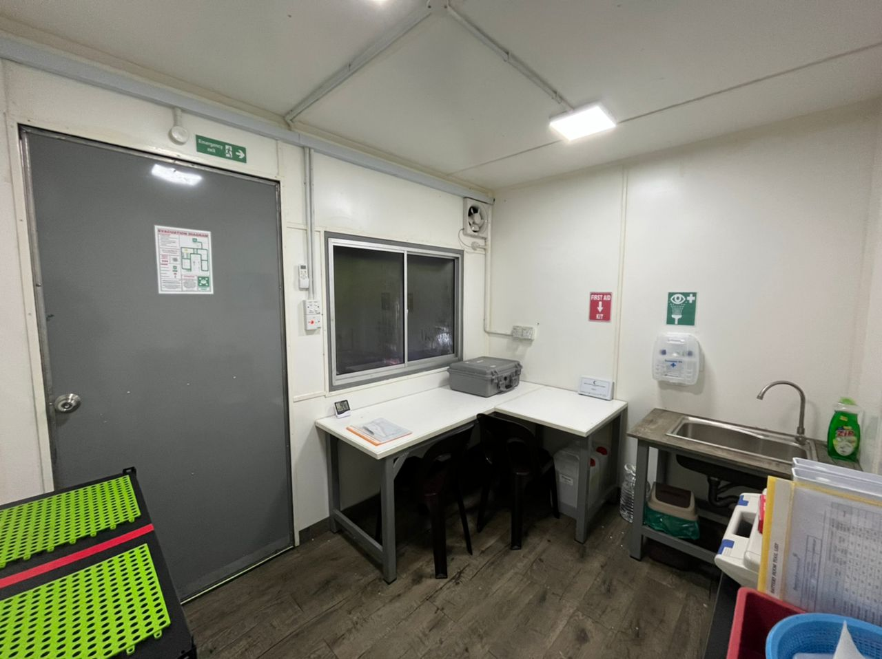
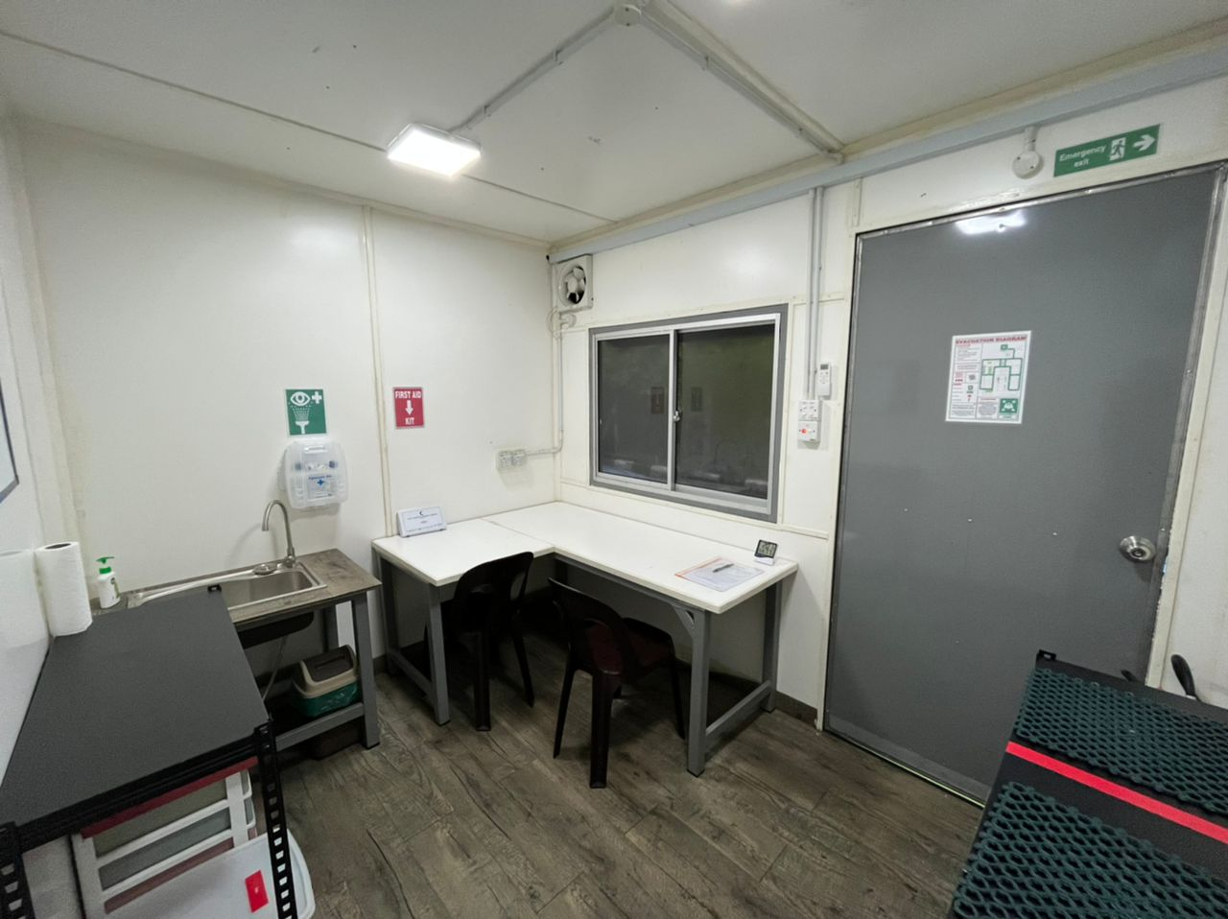
Battery Workshop at PGU KK
NICAD ROOM
LEAD ACID ROOM
Evacuation_Diagram

