Slide 2
HR INDUCTION BRIEFING

Slide 3
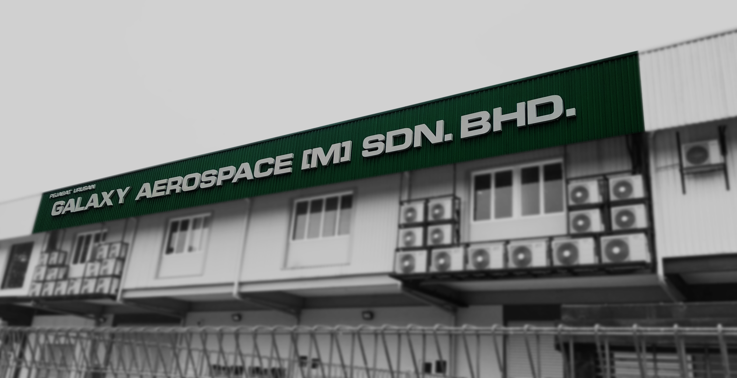
PREVIEW
This presentation will include the following elements: -
Company Background
Employment Policies

Slide 4
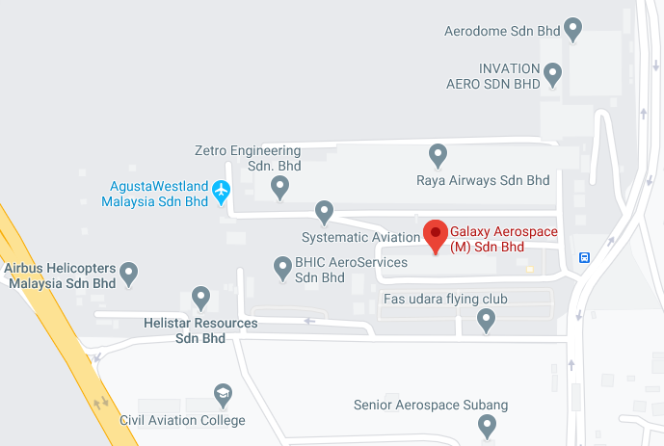
Aims to be the leading in third party Maintenance, Repair and Overhaul (MRO) company which provides client friendly, quality comprehensive aircraft maintenance support for Malaysian General Aviation.
Provides a variety of aviation services to support the demand and need in General Aviation Industry in Malaysia including helicopter and aeroplane maintenance, avionic system maintenance and upgrades, Garmin update, aviation design works, aircraft management and training.

Slide 5
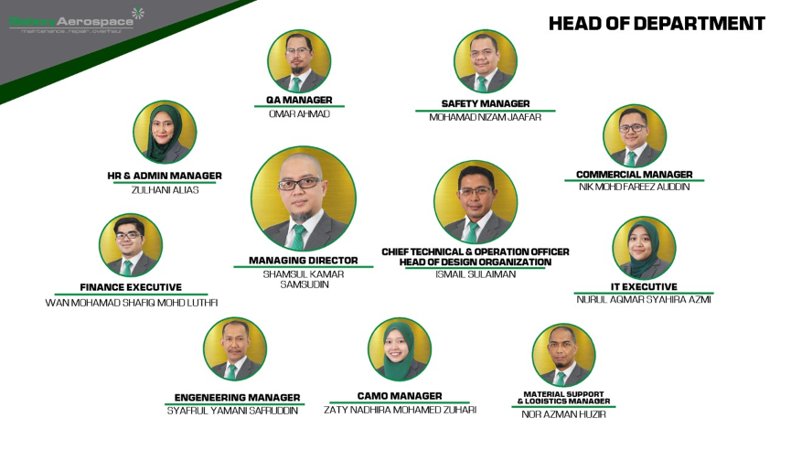
ORGANIZATION CHART

Slide 6
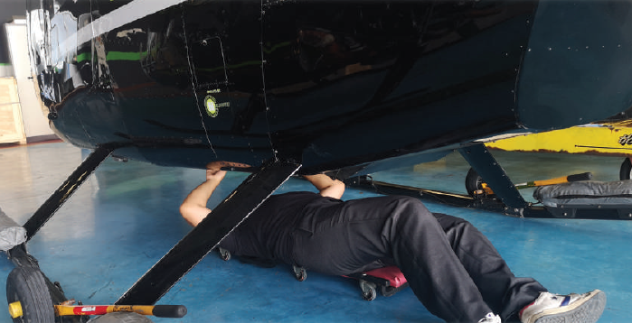
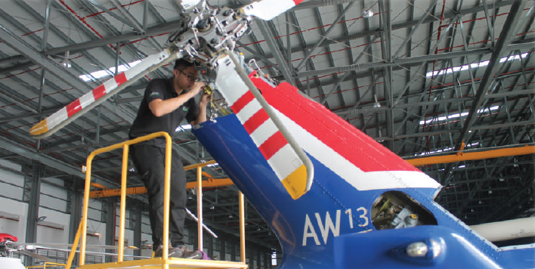
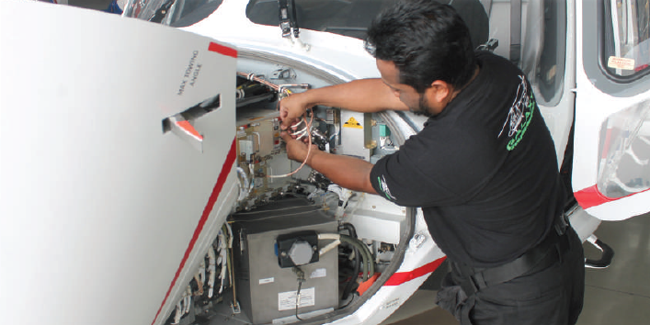
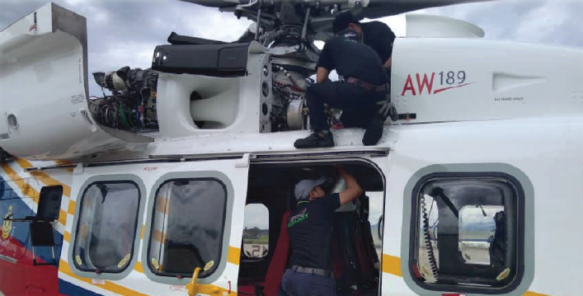
OPERATIONS
AMO – Approved Maintenance Organization Part-145
AMO – Directorate General Technical Airworthiness (DGTA)
CAMO – Continuing Airworthiness Management Organization
DOA – Design Organization Approval
Weighing Approval

Slide 7
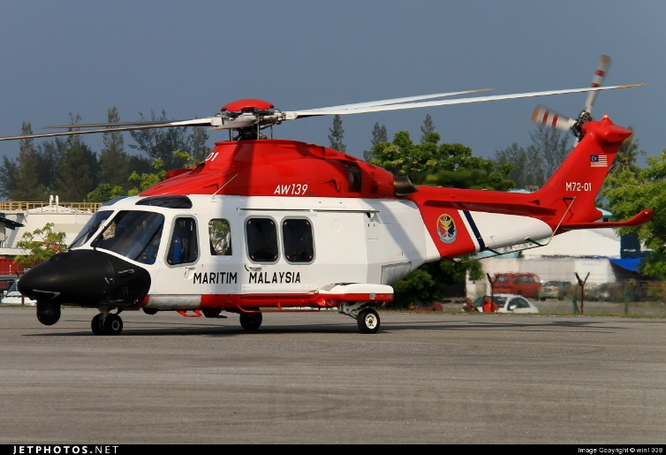
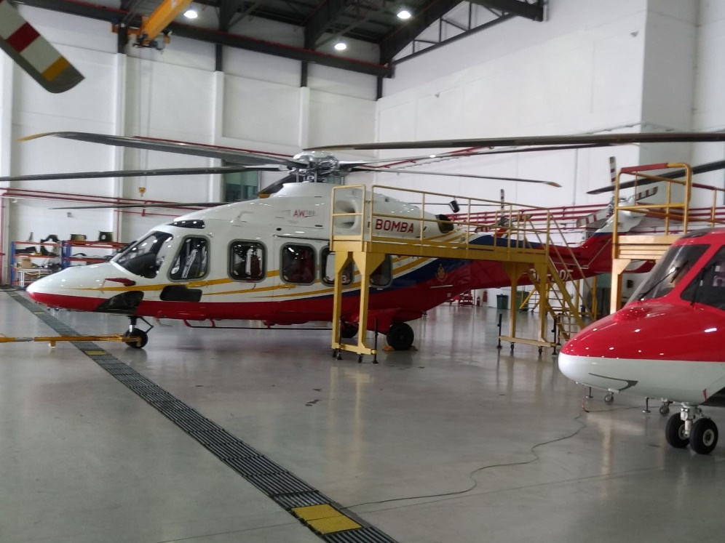
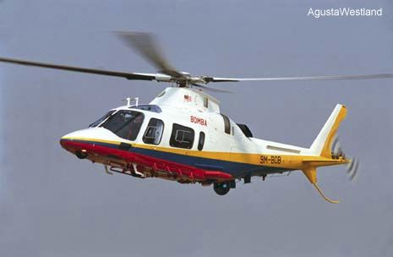
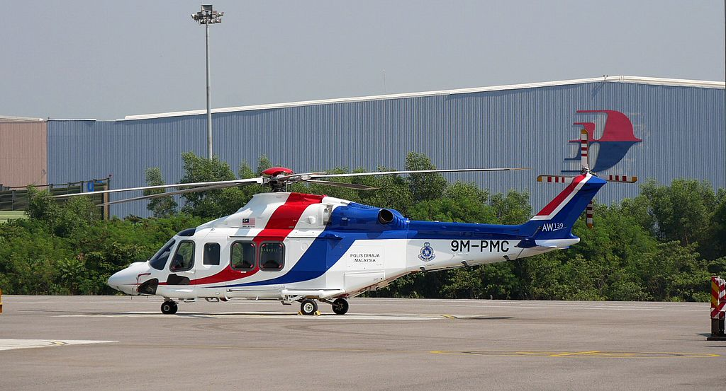
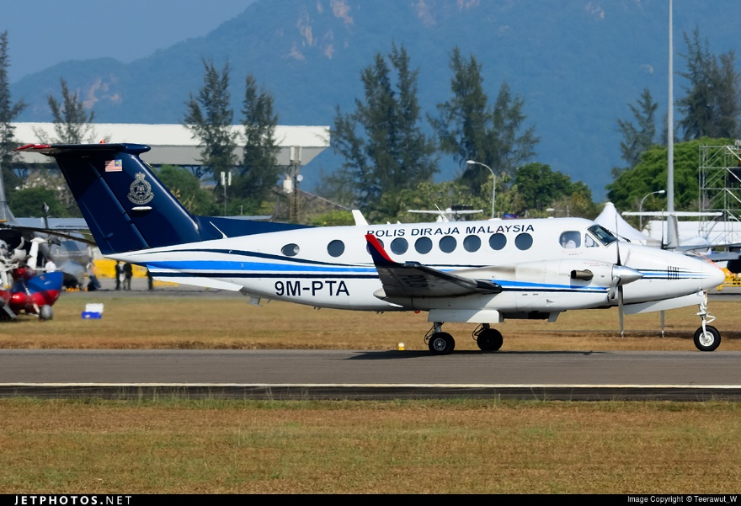
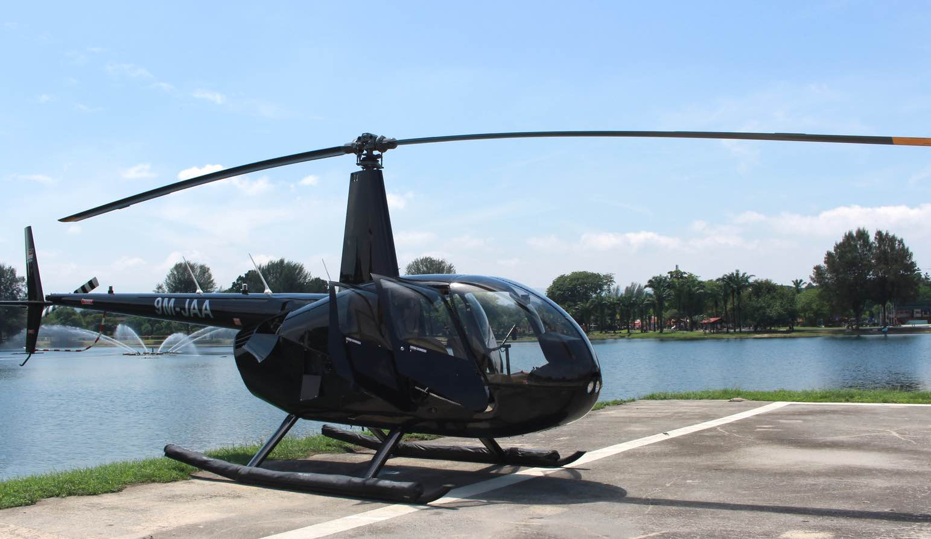
AICRAFT CAPABILITIES
AW 139
AW 189
AW 109
BEECHCRAFT KING AIR
ROBINSON

Slide 8
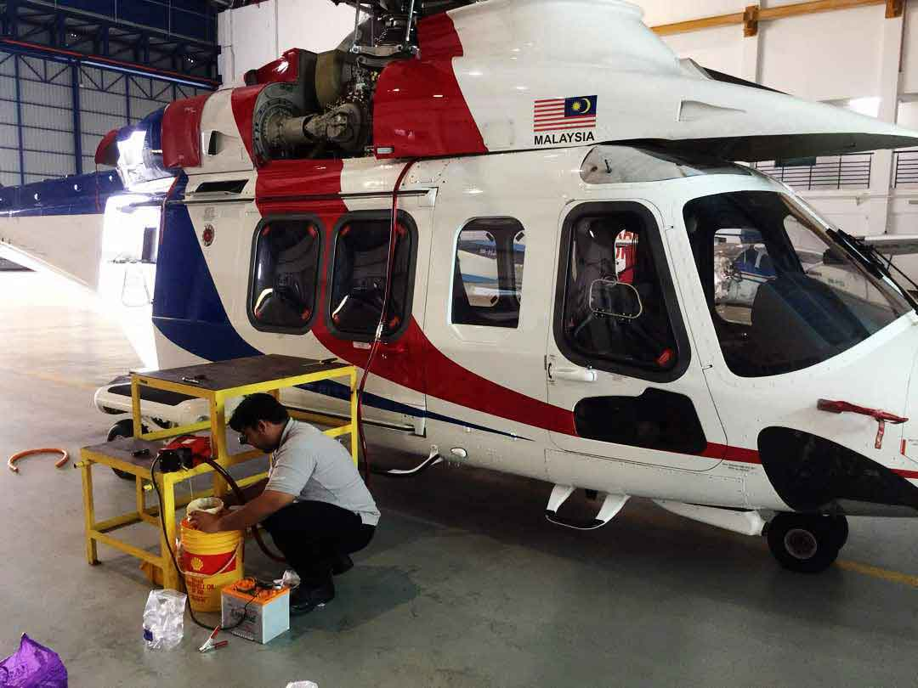
MAINTENANCE LOCATION
PGU
Pasukan Gerakan Udara (PGU),
Polis Diraja Malaysia (PDRM), Pangkalan Semenanjung,
Lapangan Terbang Sultan Aziz Shah, 47200 Subang, Malaysia
KA 300
AW 139
BERTAM
PGU KK
Bertam Fire and Rescue Department Air Base,
Kampung Tambang,13200 Kepala Batas, Penang
Air Operation Force Base Sabah Royal Malaysian Police,
Jalan Airpport, Tanjung Aru,
88100 Kota KInabalu, Sabah
AW 139
AW 109E
AW 189
KA 300
AW 139

Slide 9
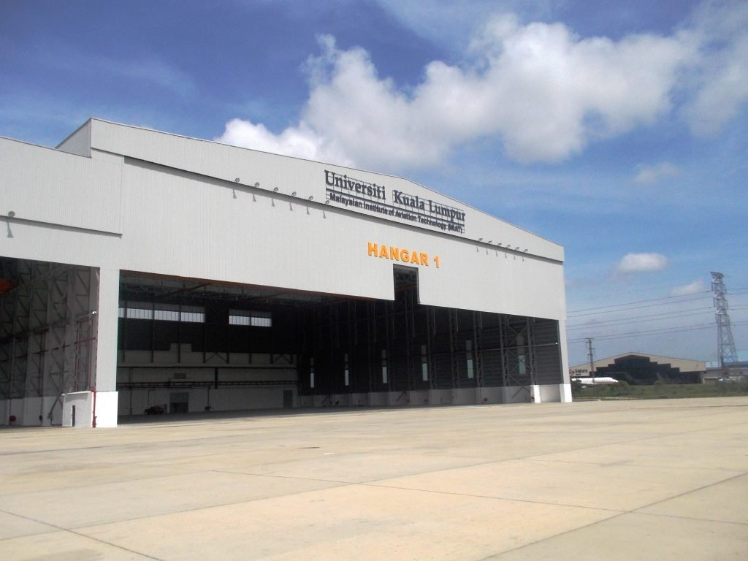
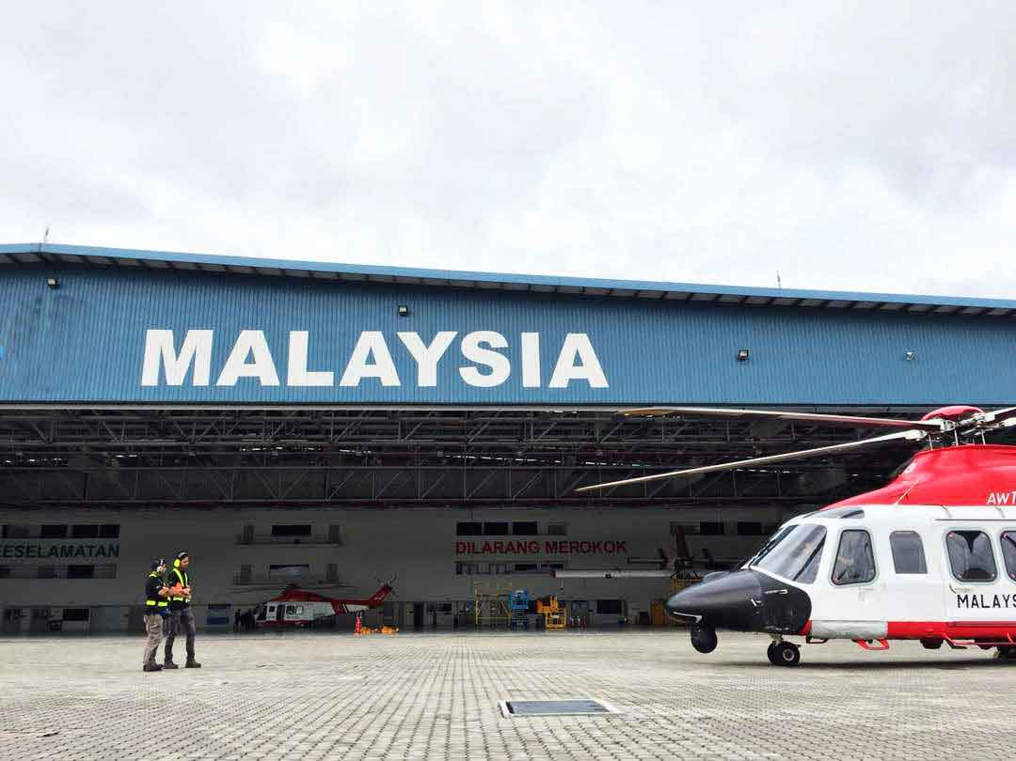
MAINTENANCE LOCATION
UNIKL MIAT HANGAR
Hangar 2, UniKL MIAT Subang Campus, Persiaran A,
Off Jalan Lapangan Terbang Subang, Seksyen U3,
47200 Subang, Selangor, Malaysia.
-JBPM
AW 139
AW 109E
AW 189
-General Aviation (GA)
APMM
AW 139
Stesen Udara Maritim Subang, Jalan TUDM, 40150 Shah Alam, Selangor, Malaysia

Slide 10
MAINTENANCE LOCATION
LANGKAWI
Helioutpost Langkawi
Helipad, Jalan Kuala Muda, 07100,
Langkawi, Kedah
R44
R66
MIRI
AW 189
Pangkalan Operasi Udara
Miri, JBPM Miri, General
Aviation, Hangar 3 MAHB
Miri Airport, 98000 Miri
Sarawak.

Slide 11
EMPLOYMENT POLICIES

Slide 12
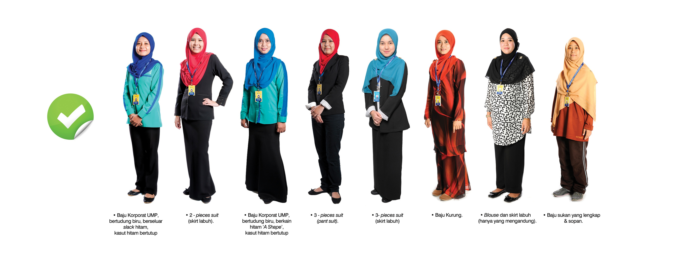
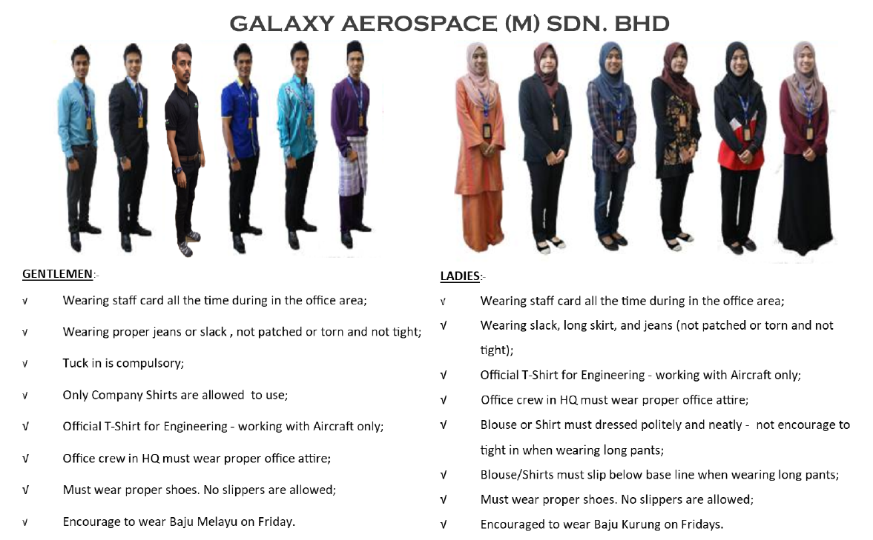
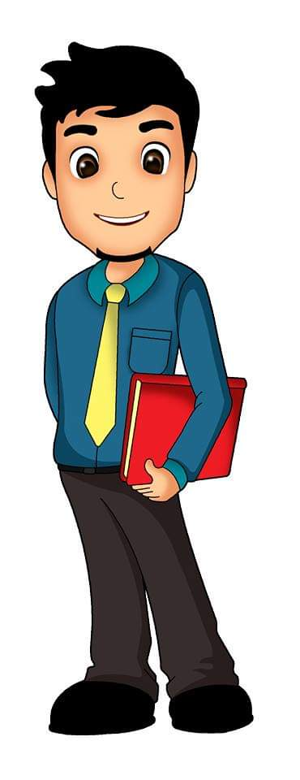
DRESS CODE

Slide 13
Official Working Hours:
48 hours per week
Monday to Friday
8.30am to 5.30pm
Standby on Saturday
Shift Hours:
Morning : 7:00am to 3.00pm
Evening : 2:00pm to 10:00pm
Rest Day : will be allocated by Supervisor
WORKING HOURS

Slide 14
 | PROBATION | TERMINATION
PROBATION | All new staff will undergo a probationary period of six (6) months | One (1) month written notice or payment of one (1) month salary in lieu of notice (based on Management justification).
CONFIRMED STAFF | Upon completion, staff will receive a confirmation letter sent via email | Three (3) months written notice or payment of Three (3) months salary in lieu of notice (based on Management justification).
PROBATIONS & TERMINATION

Slide 15
GUIDELINE USING ATTENDANCE MOBILE APP GAMS
Below is the latest Mobile App GAMS Android & IOS for every staff.
Please used App correctly.
1. Download Mobile App GAMS
Android Play Store:
https://play.google.com/store/apps/details?id=gams_app.com
IOS App Store:
https://apps.apple.com/us/app/gams-apps/id1543646881#?platform=iphone
ATTENDANCE

Slide 16
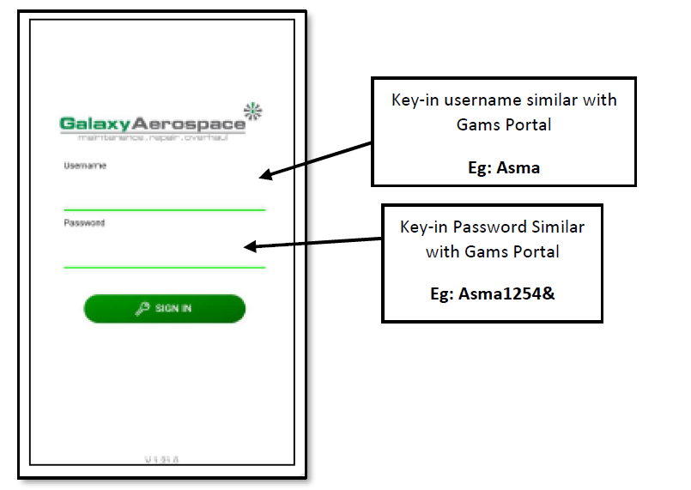
GAMS ATTENDANCE
APPS

Slide 17
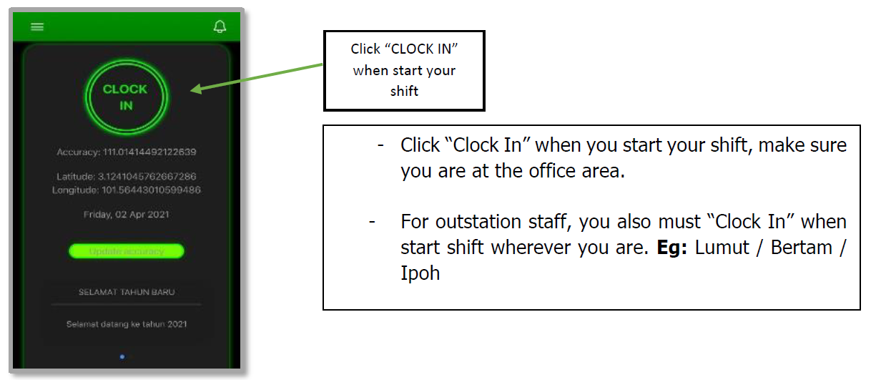
GAMS ATTENDANCE
APPS

Slide 18
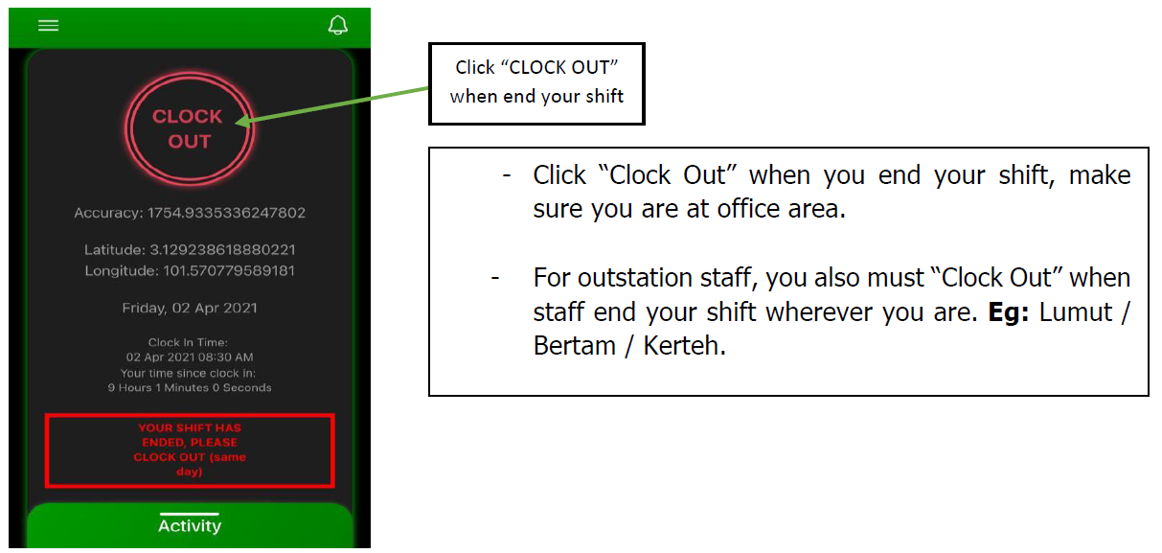
GAMS ATTENDANCE
APPS

Slide 19
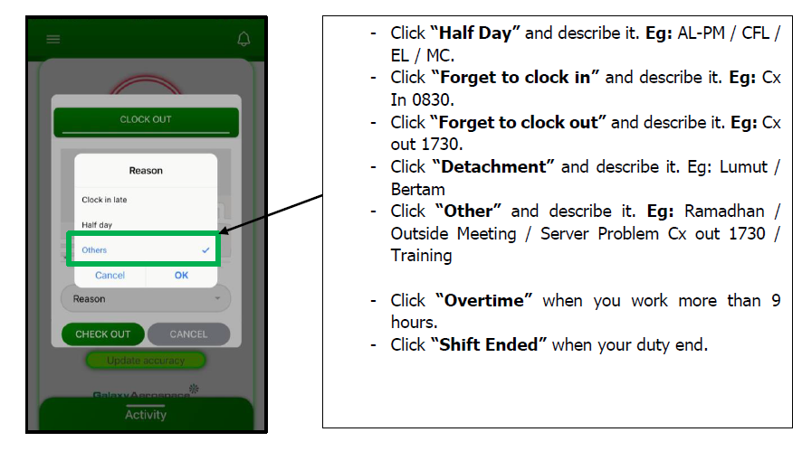
GAMS ATTENDANCE
APPS

Slide 20
LEAVES

Slide 21
LEAVES
 | ANNUAL LEAVE | GIVEN BY THE COMPANY TOTAL OF 14 DAYS FOR FULL CALENDAR YEAR | 14 DAYS
 | MEDICAL LEAVE | 14 DAYS PER YEAR FOR MC, 60 (MAX) DAYS FOR HOSPITALIZATION INCLUDED MC 14 DAYS | 14 DAYS
 | MARRIAGE LEAVE | FIRST MARRIAGE ONLY, NEED TO ATTACH SUPPORTING DOCUMENTS. | 2 DAYS
 | PATTERNITY LEAVE | UP TO 5 CHILDREN ONLY. NEED TO ATTACH SUPPORTING DOCUMENTS. | 3 DAYS
 | DEATH LEAVE | Parents/Parents In Law, Spouse, Brother, Sister, Children (inclusive of legally adopted child) | 3 DAYS
 | NATURAL CALAMITIES | NATURAL DISASTER SUCH AS FLOOD, EARTHQUAKE, STORM AND ETC. | 3 DAYS
 | UMRAH AND HAJI LEAVE | ONCE IN SERVICE FOR BOTH UMRAH AND HAJI. UMRAH = 7 DAYS, HAJI = AS PER PLANNED | AS PLANNED
 | EMERGENCY LEAVE | EMERGENCY DUE TO UNCONTROLABLE CIRCUMSTANCES. WILL DEDUCT AL IF THE REASON ACCEPTED ORELSE WILL BE UNPAID LEAVES. | DEPEND ON CONSIDERATION BY HOD

Slide 22
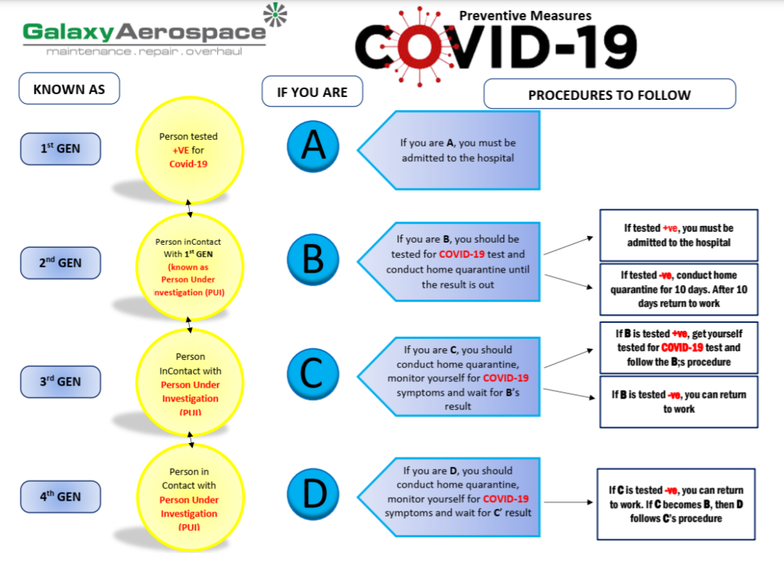
COVID-19 INFO
ORDER FOR SURVEILLANCE AND OBSERVATION FOR CONTACT OF COVID-19
All crew of Galaxy Aerospace (M) Sdn Bhd who’s coming back from areas (affected with Covid-19 virus) to TAKE ALL NECESSARY PRECAUTIONARY MEASURES for this pandemic.
INFORM YOUR SUPERIOR OR HOD IF YOU ARE INVOLVED OR HAVING INTERACTION WITH PERSON WHO TESTED +VE COVID-19.
ALL PCR/RTK SWAB TEST MUST THROUGH ADMIN DEPT. IF YOU ARE OUTSIDE KLANG VALLEY, YOU CAN FIND YOUR OWN CLINIC FOR PCR/RTK SWAB TEST AND THE MAX. PRICE IS RM 250.00 FOR PCR SWAB TEST AND RM 100.00 FOR RTK SWAB TEST

Slide 23
COVID-19 INFO
DISCLAIMER:
Please be reminded that any employees which absent from work after being affected with Covid-19 virus including home quarantine as instructed by KKM due to negligent or from non-work related, the said employee shall bear for the swab test and the quarantine cost and need to utilizing the medical leave, Annual Leave or unpaid leave during the quarantine period.
Ref:
GAM-HR/OA/20/0101
GAM-HR/OA/20/0134

Slide 24
COMPANY CAR BOOKING & ROOM BOOKING
Inform Admin Dept.
Request at least 3 days for PROPER preparation.
PARKING
For Oasis, max payment up to RM120.00 per month
For GAM, please do not park in front of GAM office door
Other base, follow client rules and regulation.
LEAVE APPLICATION
Annual Leave must be planned annually.
Application through GAMS Apps and must inform your superior/HOD for immediate response.
Application of AL must be done 3 days before. Below then 3 days, need to apply Emergency Leave and AL will be deducted.
NOTICE AND INFORMATION
All information, notice and announcement shall be read on GAMS Apps on Official Announcement (OA)
Unread OA will be calculated, and the staff will be penalized in various term like cut off bonus, ETC.
CLAIM
Staff are eligible for Medical Claim, Detachment Claim, Personal Protection Equipment, and others claim that can be found on HR Employee Handbook.
All Claim must be submitted with complete signature from supervisor/HOD. All original receipt must attach along with the claim. Company will not accept the claim if the staff unable to complete the supporting document.
The max duration for claim submission is 3 months otherwise will be forfeited.

Slide 25
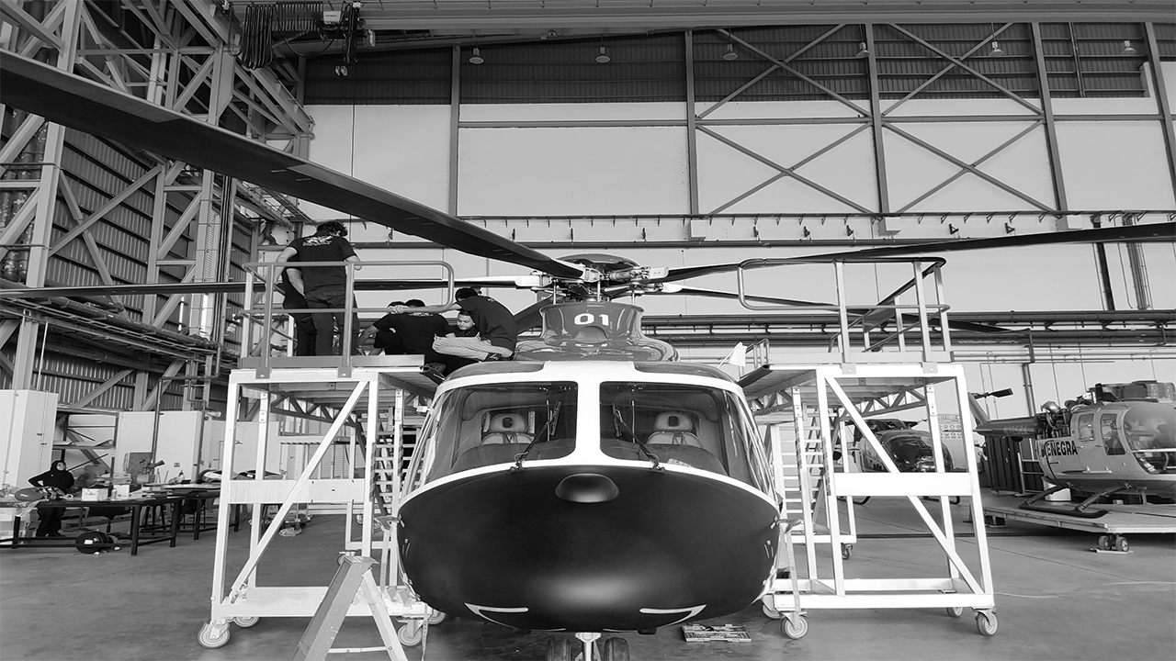
THANK YOU
Any question?

